Slide 1
Cloud Front
OW

Slide 2
Overview
Amazon CloudFront is a fast content delivery network (CDN) service that securely delivers data, videos, applications, and APIs to customers globally with low latency, high transfer speeds, all within a developer-friendly environment.
Amazon CloudFront is a web service that speeds up distribution of your static and dynamic web content, such as .html, .css, .js, and image files, to your users. CloudFront delivers your content through a worldwide network of data centers called edge locations.

Slide 3
How it works?
If the content is already in the edge location with the lowest latency, CloudFront delivers it immediately.
If the content is not in that edge location, CloudFront retrieves it from an origin that you’ve defined — such as an Amazon S3 bucket, a MediaPackage channel, or an HTTP server (for example, a web server) that you have identified as the source for the definitive version of your content.

Slide 4
..
CloudFront works seamlessly with any AWS origin, such as Amazon S3, Amazon EC2, Elastic Load Balancing, or with any custom HTTP origin. You can customize your content delivery through CloudFront using the secure and programmable edge computing features CloudFront Functions and AWS Lambda@Edge.

Slide 5
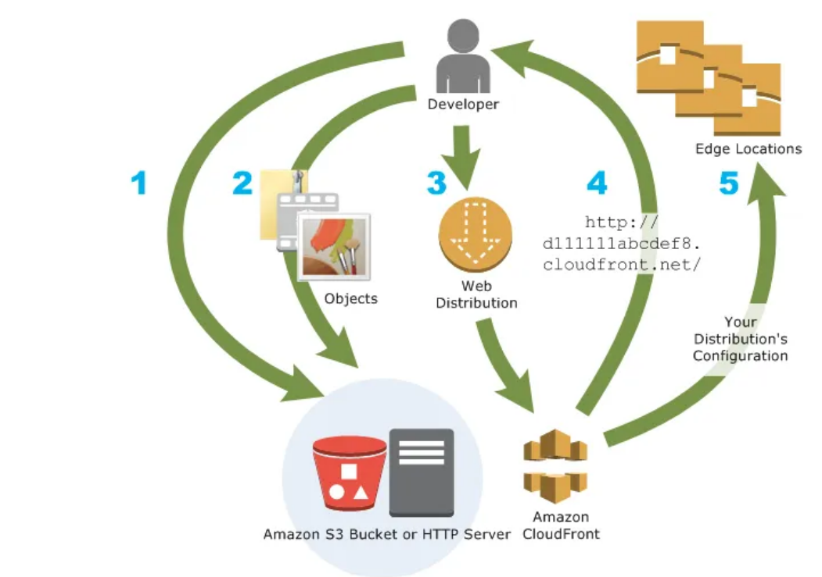
..

Slide 6
Key Benefits
Amazon CloudFront is massively scaled and globally distributed. The CloudFront network has 225+ points of presence (PoPs) that are interconnected via the AWS backbone delivering ultra-low latency performance and high availability to your end users.
The AWS backbone is a private network built on a global, fully redundant, parallel 100 GbE metro fiber network linked via trans-oceanic cables across the Atlantic, Pacific, and Indian Oceans, as well as, the Mediterranean, Red Sea, and South China Seas.

Slide 7
Integration with Aws
Amazon CloudFront is integrated with AWS services such as Amazon S3, Amazon EC2, Elastic Load Balancing, Amazon Route 53, and AWS Elemental Media Services for easy set-up.
As a developer, you can use the AWS management console or familiar developer tools such as CloudFormation templates, the AWS Cloud Development Kit, and APIs. CloudFront’s integration with Amazon Cloudwatch and Kinesis offers real-time observability through metrics and logs.

Slide 8
Security At Edge
Amazon CloudFront is a highly secure CDN that provides both network and application level protection. All your CloudFront distributions are defended by default against the most frequently occurring network and transport layer DDoS attacks that target your websites or applications with AWS Shield Standard.
To defend against more complex attacks, you can add a flexible, layered security perimeter by integrating CloudFront with AWS Shield Advanced and AWS Web Application Firewall (WAF). Firewall rules, curated and managed by Amazon security experts, to protect against common CVEs and OWASP

Slide 9
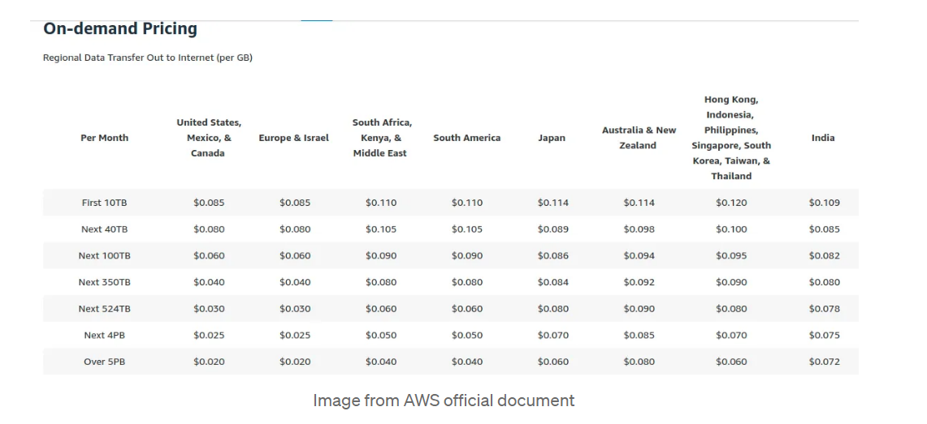
Pricing

Slide 10
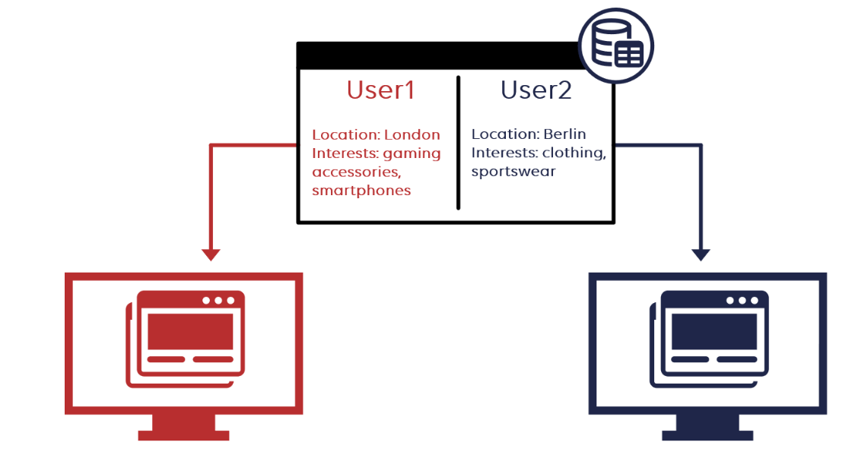
Dynamic Content
Dynamic content refers to web content that changes based on user behavior, preferences, and interests. It refers to website content, which is generated when a user requests a page.

Slide 11
Labs
Create VPC
Create EC2 instance
Make webserver to EC2 instance
Launch cloud front

